Slide 1

Welcome to Class 4’s Collective Worship

Slide 2

God says:
“look after the world; look after one another; take care of the fish and the birds, the animals and the reptiles, the trees and the flowers and the plants.”
Let’s gather together by singing: Into the World
Please join in!

Slide 3
Class 4 are the school’s eco ambassadors, the Eco Warriors, and our job is to raise awareness of issues affecting our environment and our common home and to help everyone in the school learn how to be more eco friendly.

Slide 4
Our Eco Warrior Mission links to many of our Catholic Social Teaching values:
Common Good – because it’s good for everyone if our Earth is healthy.
Care and Creation – because we are stewards of the Earth and its animals and people and we need to take care of God’s creation.
Work and Participation – because we all have to work together to help the Earth and create a brighter future.

Slide 5
We express the greatness of God by the love we show each other. Another way to express our love of God is by taking care of the Earth, our Common Home.
A long time ago, one of the priests in the Temple in Jerusalem wrote about the creation of world and its people. We will read about this story in the Book of Genesis.

Slide 6
A Reading from The Book of Genesis
²⁶ Then God said, “Let us make human beings in our image and likeness. And let them rule over the fish in the sea and the birds in the sky. Let them rule over the tame animals, over all the earth and over all the small crawling animals on the earth.”
²⁷ So God created human beings in his image. In the image of God he created them. He created them male and female. ²⁸ God blessed them and said, “Have many children and grow in number. Fill the earth and be its master. Rule over the fish in the sea and over the birds in the sky. Rule over every living thing that moves on the earth.”

Slide 7
²⁹ God said, “Look, I have given you all the plants that have grain for seeds. And I have given you all the trees whose fruits have seeds in them. They will be food for you. ³⁰ I have given all the green plants to all the animals to eat. They will be food for every wild animal, every bird of the air and every small crawling animal.” And it happened. ³¹ God looked at everything he had made, and it was very good.
The Word of the Lord
- Thanks be to God.

Slide 8
In the scripture we heard how God gave us the Earth and entrusted us to keep it safe.
Pope Francis wrote the Laudato Si to remind us how important it is to take care of Our Common Home. As part of our response, we would like to show you a short video.

Slide 9
Laudato Si' animation for children (cafod.org.uk)

Slide 10
Sorry Prayer
Response: Lord, we are sorry.

Slide 11
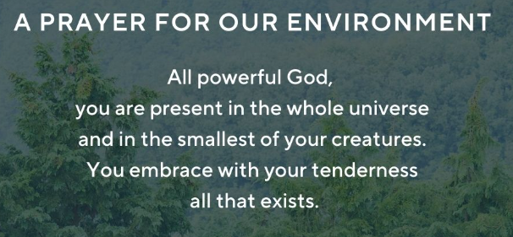
Let us say together a prayer for our environment.

Slide 12
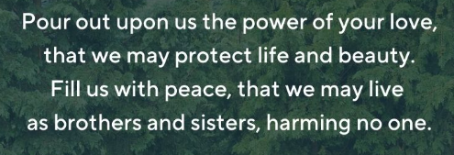

Slide 13
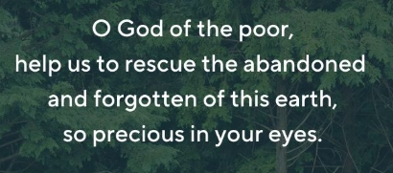

Slide 14
God says:
“look after the world; look after one another; take care of the fish and the birds, the animals and the reptiles, the trees and the flowers and the plants.”
Look at the following photos whilst thinking about God’s message.

Slide 15

“look after the world; look after one another; take care of the fish and the birds, the animals and the reptiles, the trees and the flowers and the plants.”

Slide 16
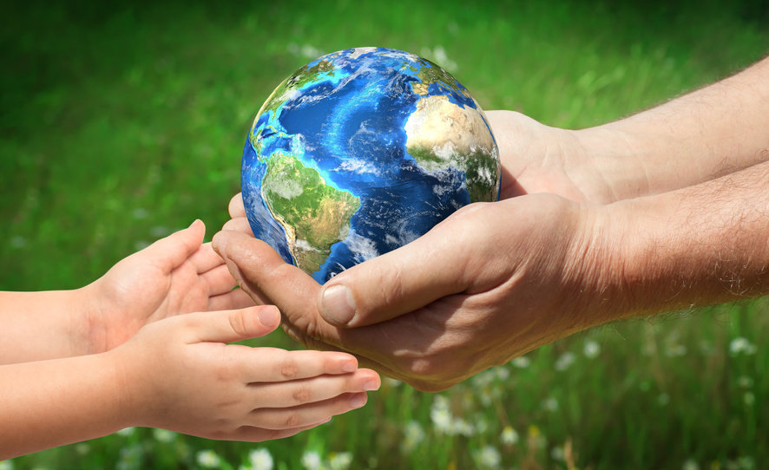
“look after the world; look after one another; take care of the fish and the birds, the animals and the reptiles, the trees and the flowers and the plants.”

Slide 17
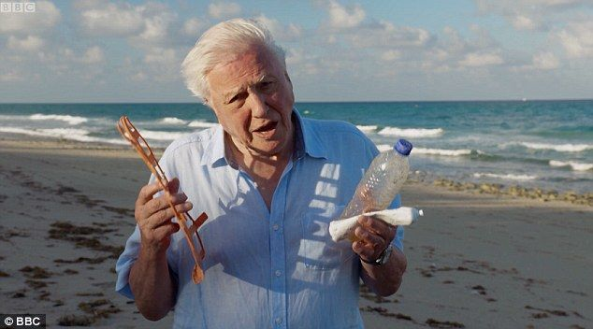
“look after the world; look after one another; take care of the fish and the birds, the animals and the reptiles, the trees and the flowers and the plants.”

Slide 18
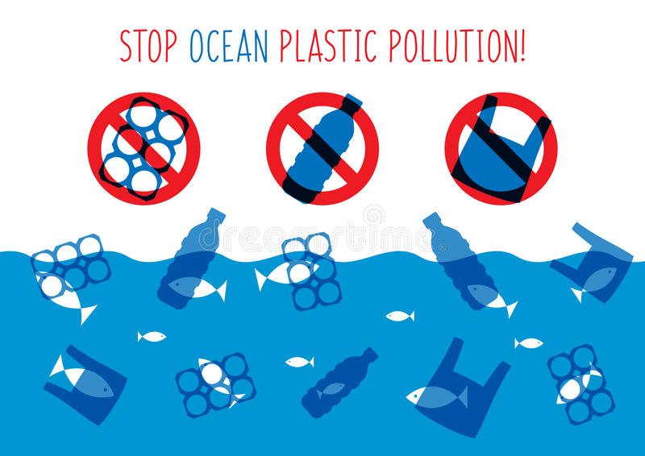
“look after the world; look after one another; take care of the fish and the birds, the animals and the reptiles, the trees and the flowers and the plants.”

Slide 19
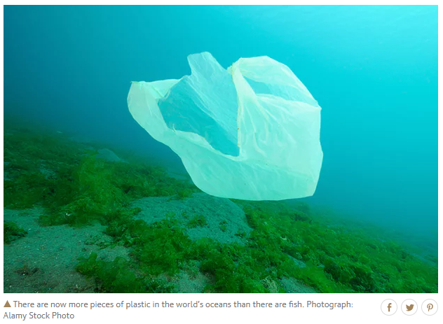
“look after the world; look after one another; take care of the fish and the birds, the animals and the reptiles, the trees and the flowers and the plants.”

Slide 20
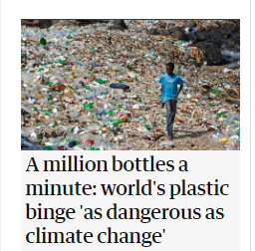
“look after the world; look after one another; take care of the fish and the birds, the animals and the reptiles, the trees and the flowers and the plants.”

Slide 21
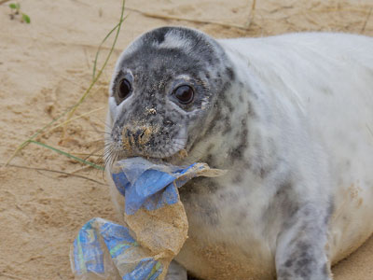
“look after the world; look after one another; take care of the fish and the birds, the animals and the reptiles, the trees and the flowers and the plants.”

Slide 22
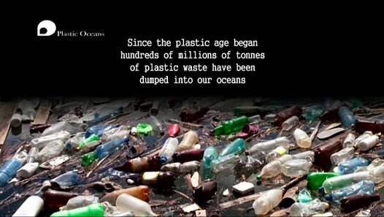
“look after the world; look after one another; take care of the fish and the birds, the animals and the reptiles, the trees and the flowers and the plants.”

Slide 23
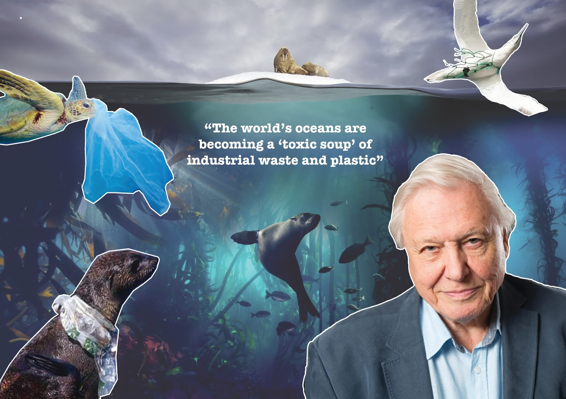
“look after the world; look after one another; take care of the fish and the birds, the animals and the reptiles, the trees and the flowers and the plants.”

Slide 24
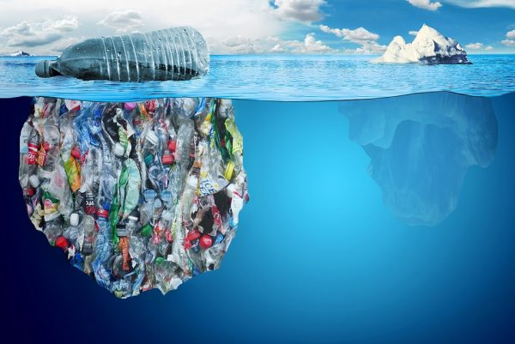
“look after the world; look after one another; take care of the fish and the birds, the animals and the reptiles, the trees and the flowers and the plants.”

Slide 25
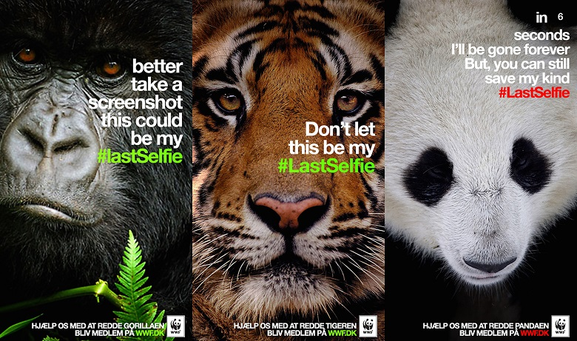
“look after the world; look after one another; take care of the fish and the birds, the animals and the reptiles, the trees and the flowers and the plants.”

Slide 26
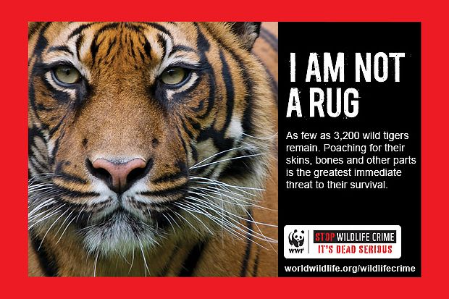
“look after the world; look after one another; take care of the fish and the birds, the animals and the reptiles, the trees and the flowers and the plants.”

Slide 27

“look after the world; look after one another; take care of the fish and the birds, the animals and the reptiles, the trees and the flowers and the plants.”

Slide 28
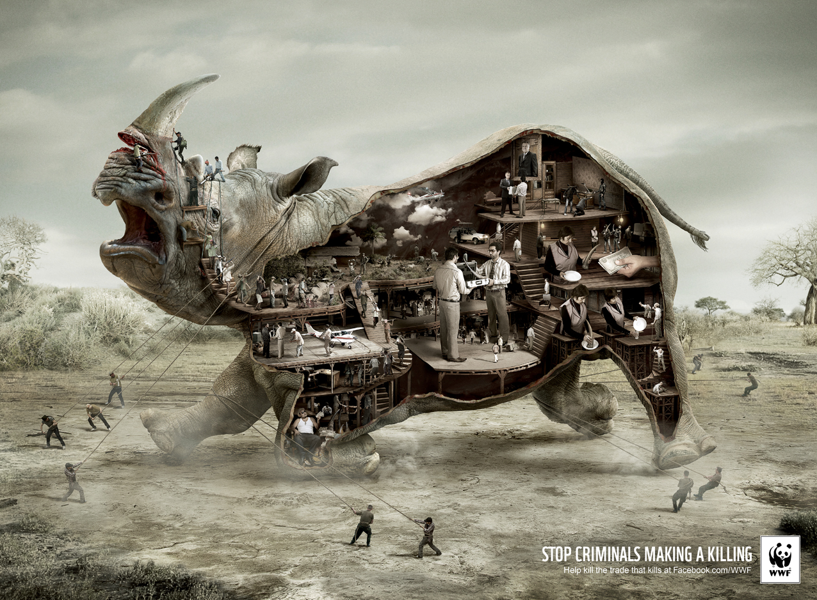
“look after the world; look after one another; take care of the fish and the birds, the animals and the reptiles, the trees and the flowers and the plants.”

Slide 29
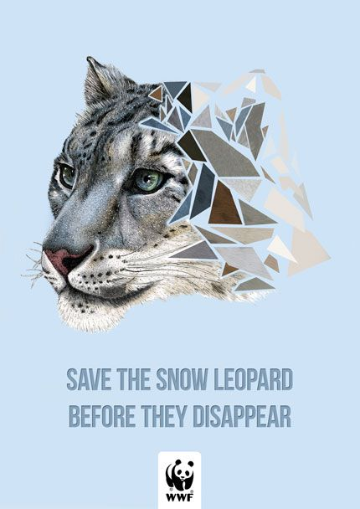
“look after the world; look after one another; take care of the fish and the birds, the animals and the reptiles, the trees and the flowers and the plants.”

Slide 30
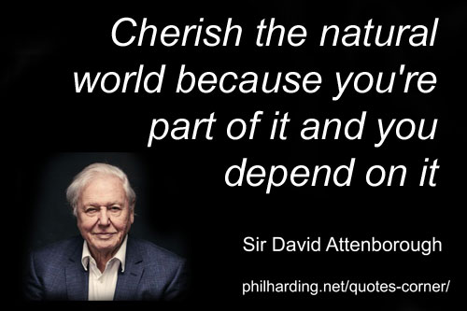
“look after the world; look after one another; take care of the fish and the birds, the animals and the reptiles, the trees and the flowers and the plants.”

Slide 31
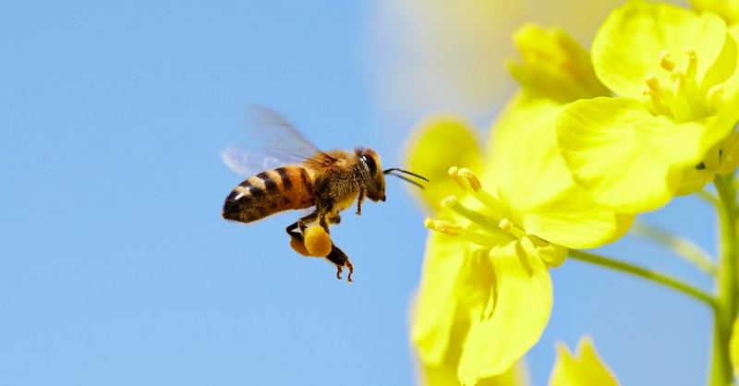
“look after the world; look after one another; take care of the fish and the birds, the animals and the reptiles, the trees and the flowers and the plants.”

Slide 32
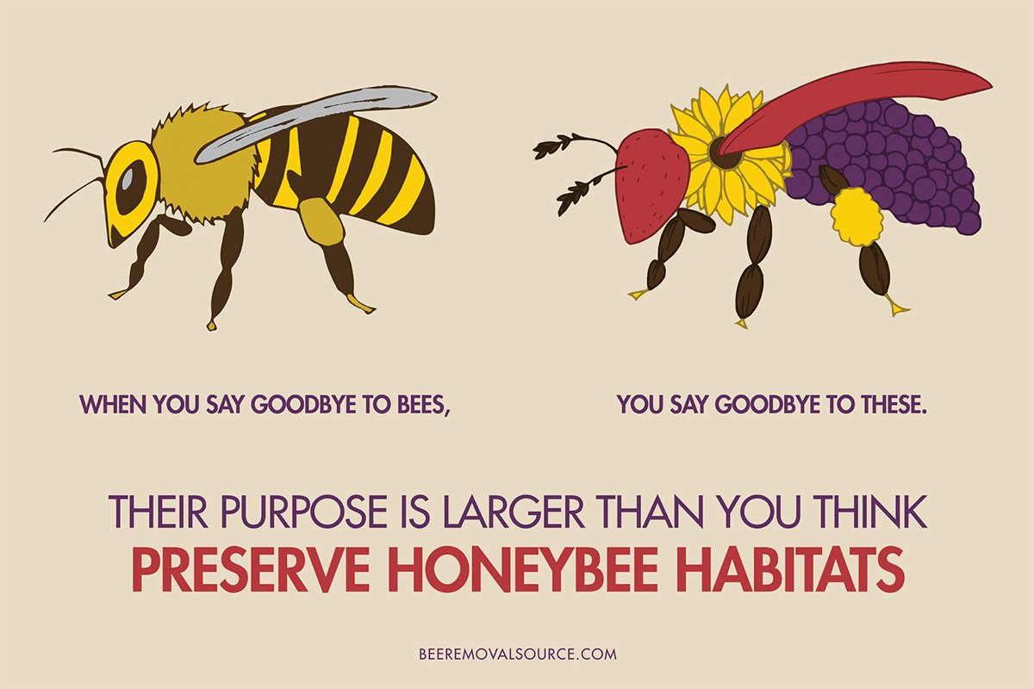
“look after the world; look after one another; take care of the fish and the birds, the animals and the reptiles, the trees and the flowers and the plants.”

Slide 33
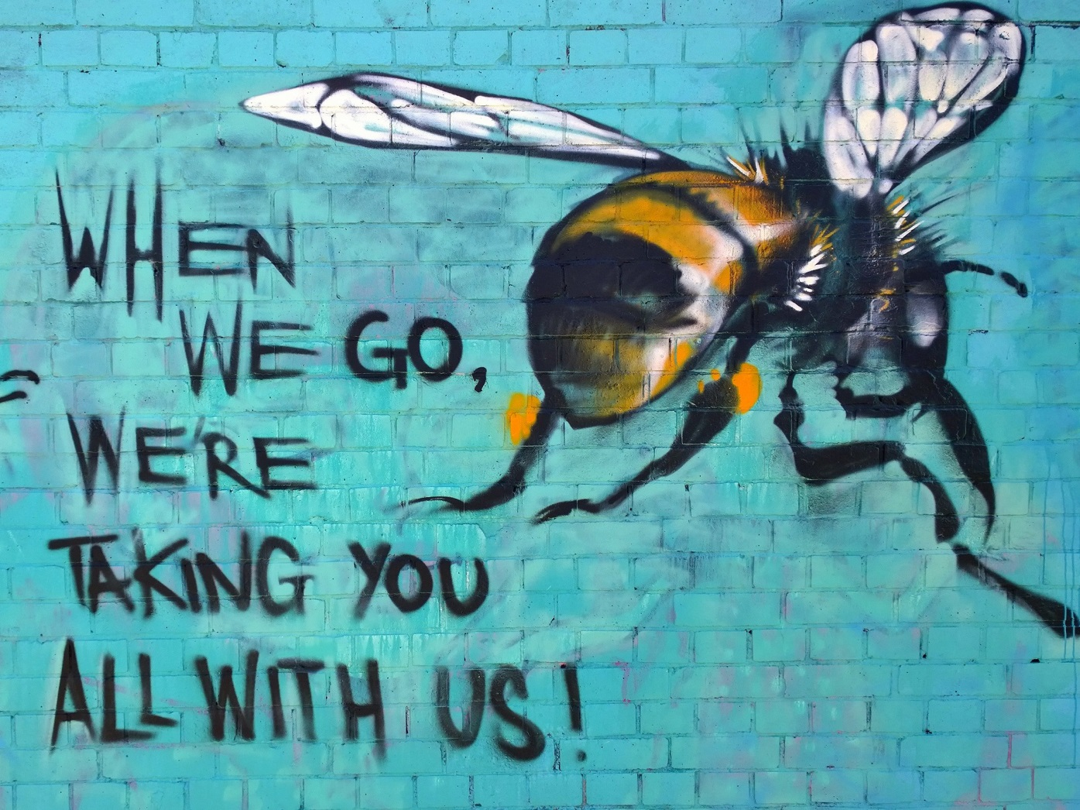
“look after the world; look after one another; take care of the fish and the birds, the animals and the reptiles, the trees and the flowers and the plants.”

Slide 34
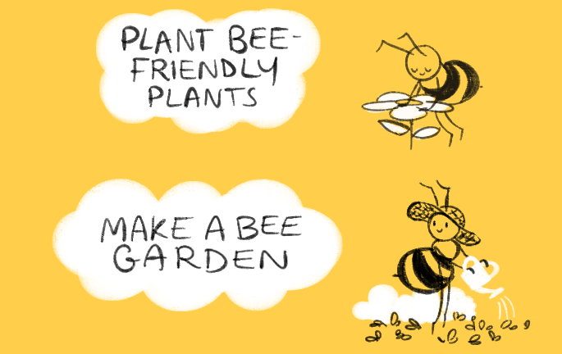
“look after the world; look after one another; take care of the fish and the birds, the animals and the reptiles, the trees and the flowers and the plants.”

Slide 35
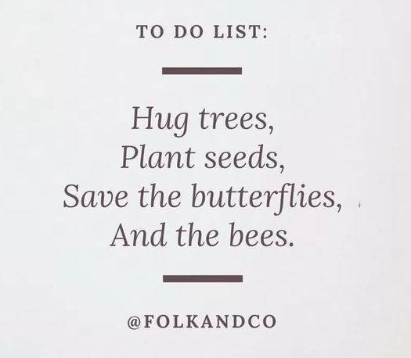
“look after the world; look after one another; take care of the fish and the birds, the animals and the reptiles, the trees and the flowers and the plants.”

Slide 36
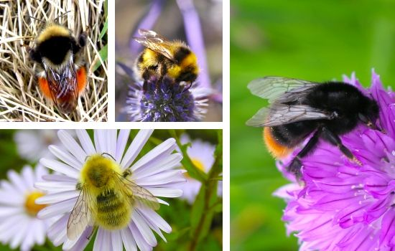
“look after the world; look after one another; take care of the fish and the birds, the animals and the reptiles, the trees and the flowers and the plants.”

Slide 37
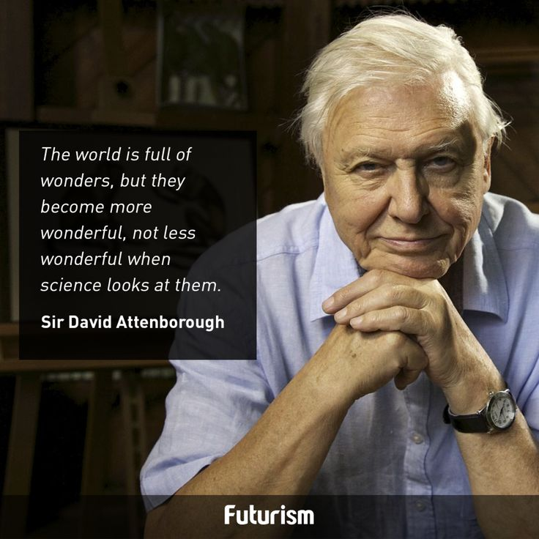
“look after the world; look after one another; take care of the fish and the birds, the animals and the reptiles, the trees and the flowers and the plants.”

Slide 38
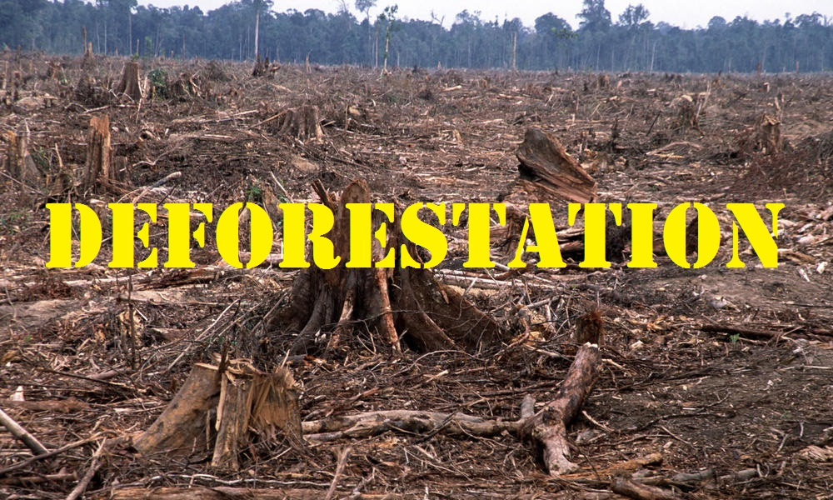
“look after the world; look after one another; take care of the fish and the birds, the animals and the reptiles, the trees and the flowers and the plants.”

Slide 39
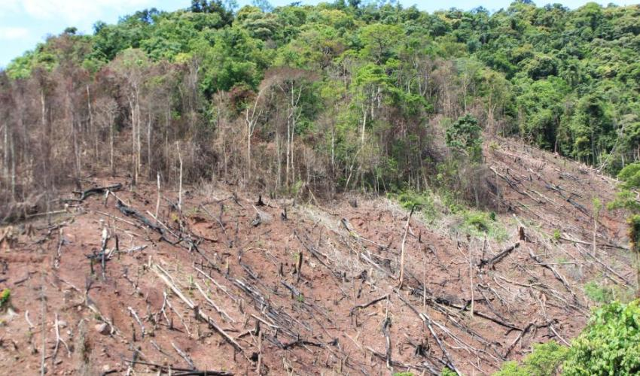
“look after the world; look after one another; take care of the fish and the birds, the animals and the reptiles, the trees and the flowers and the plants.”

Slide 40
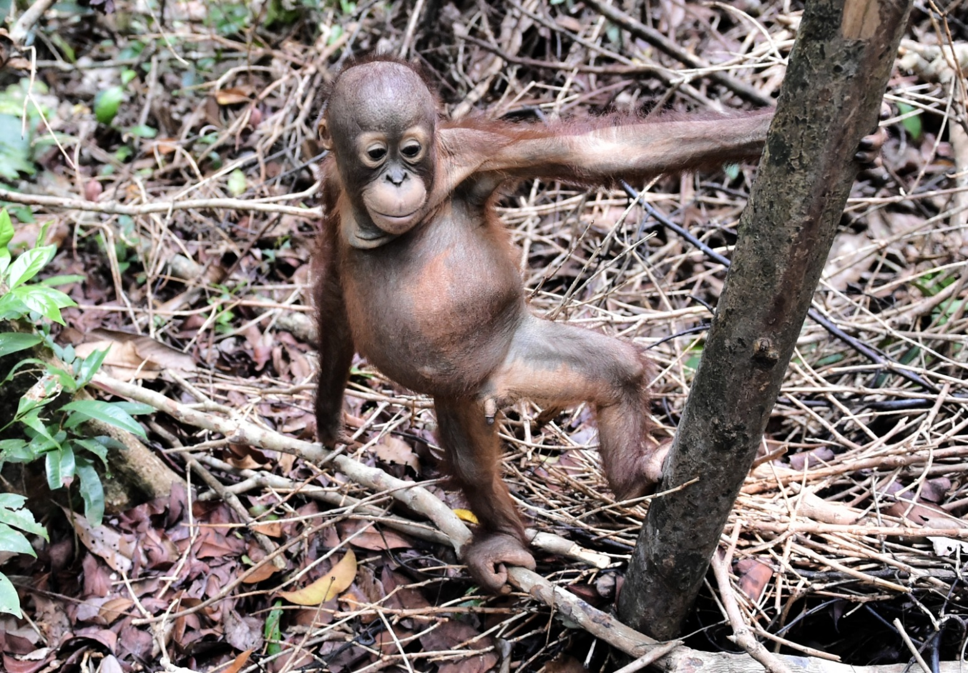
“look after the world; look after one another; take care of the fish and the birds, the animals and the reptiles, the trees and the flowers and the plants.”

Slide 41
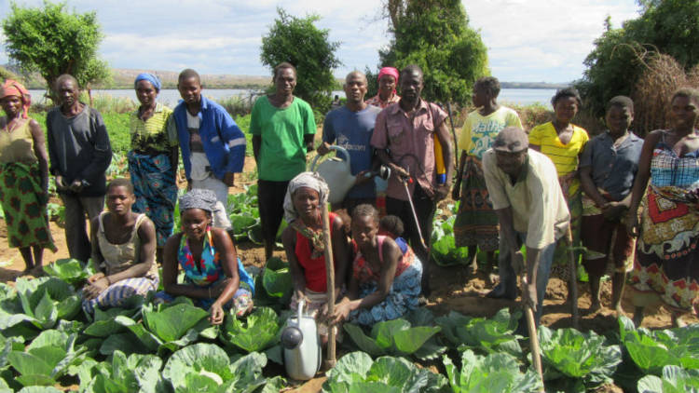
“look after the world; look after one another; take care of the fish and the birds, the animals and the reptiles, the trees and the flowers and the plants.”

Slide 42
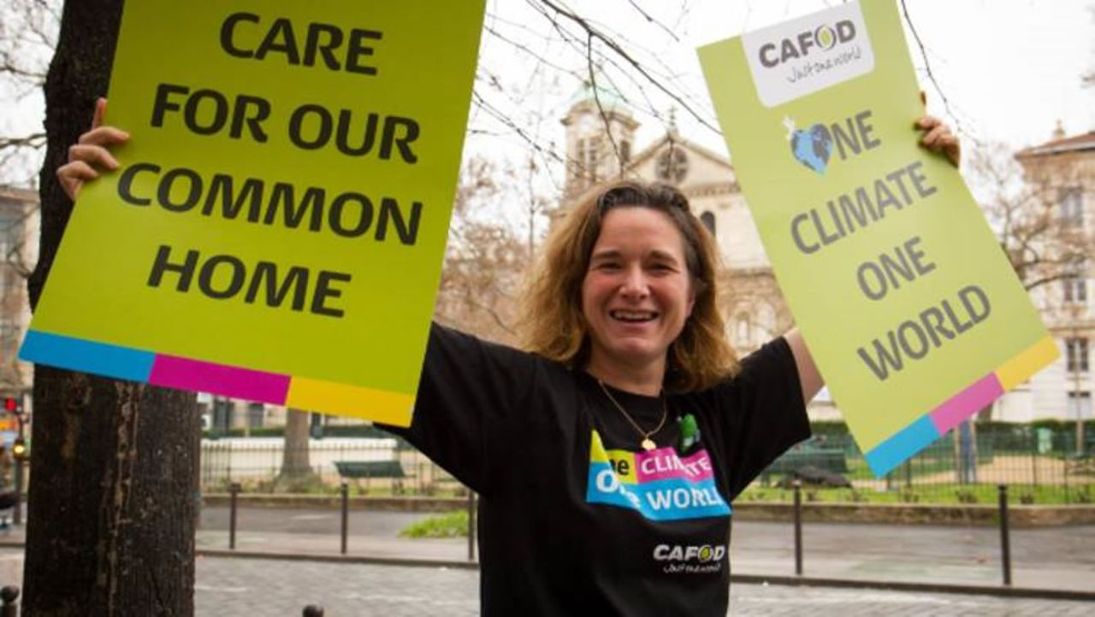
“look after the world; look after one another; take care of the fish and the birds, the animals and the reptiles, the trees and the flowers and the plants.”

Slide 43
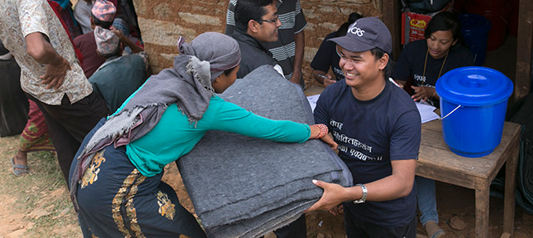
“look after the world; look after one another; take care of the fish and the birds, the animals and the reptiles, the trees and the flowers and the plants.”

Slide 44
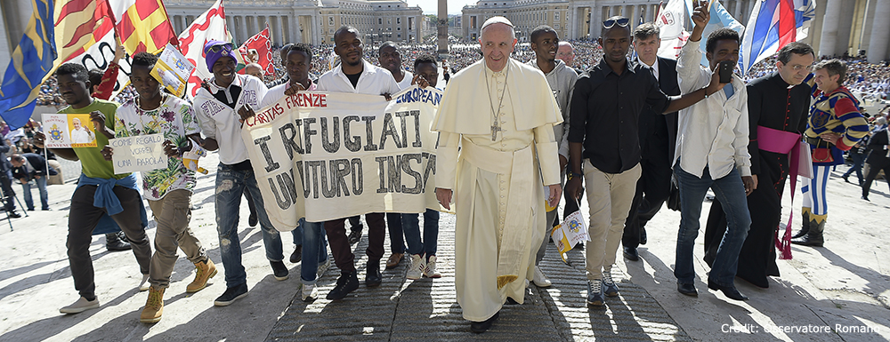
“look after the world; look after one another; take care of the fish and the birds, the animals and the reptiles, the trees and the flowers and the plants.”

Slide 45
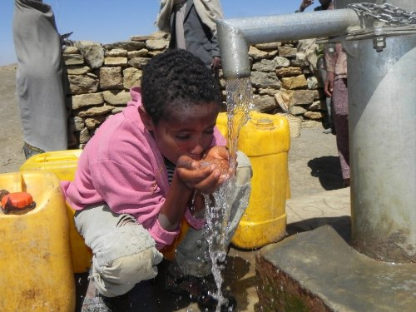
“look after the world; look after one another; take care of the fish and the birds, the animals and the reptiles, the trees and the flowers and the plants.”

Slide 46
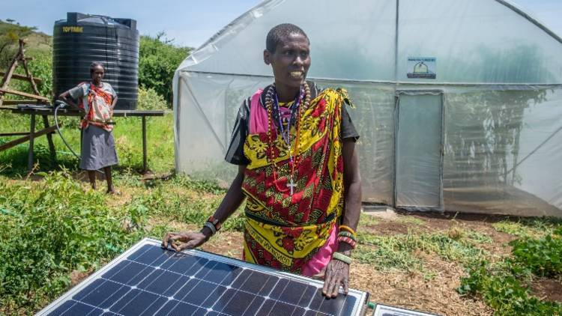
“look after the world; look after one another; take care of the fish and the birds, the animals and the reptiles, the trees and the flowers and the plants.”

Slide 47
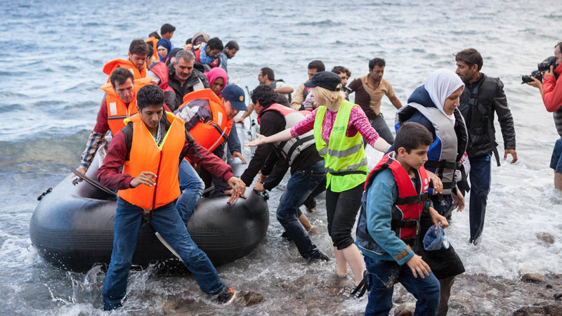
“look after the world; look after one another; take care of the fish and the birds, the animals and the reptiles, the trees and the flowers and the plants.”

Slide 48
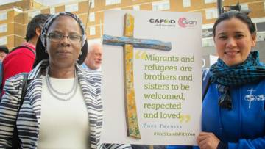
“look after the world; look after one another; take care of the fish and the birds, the animals and the reptiles, the trees and the flowers and the plants.”

Slide 49
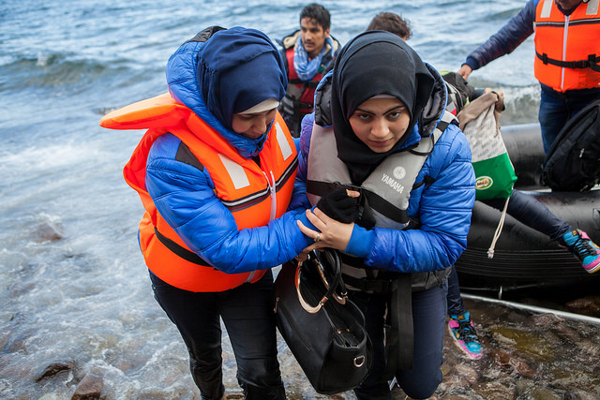
“look after the world; look after one another; take care of the fish and the birds, the animals and the reptiles, the trees and the flowers and the plants.”

Slide 50
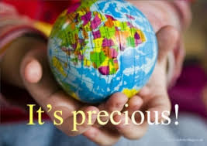
“look after the world; look after one another; take care of the fish and the birds, the animals and the reptiles, the trees and the flowers and the plants.”

Slide 51
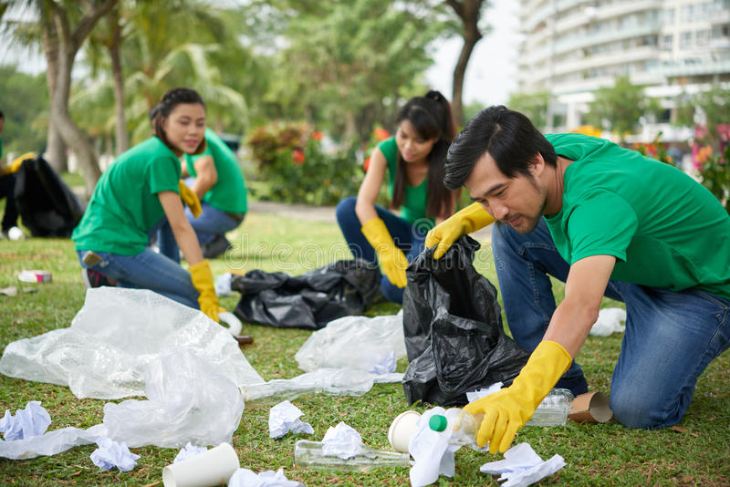
“look after the world; look after one another; take care of the fish and the birds, the animals and the reptiles, the trees and the flowers and the plants.”

Slide 52
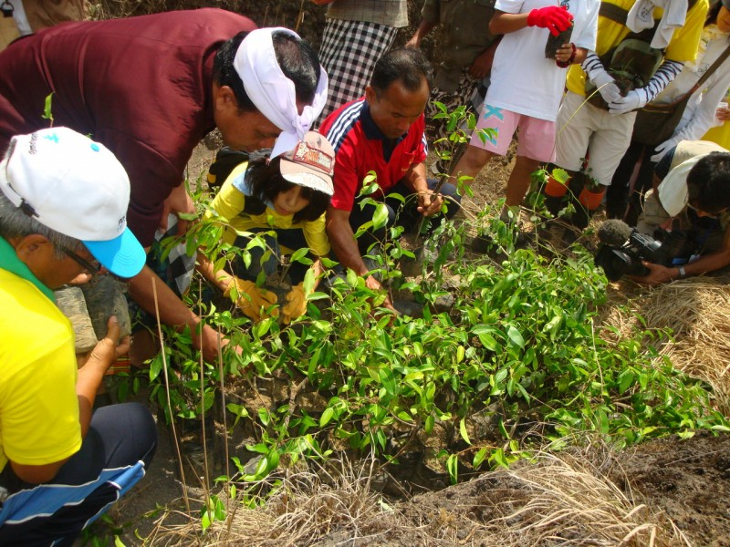
“look after the world; look after one another; take care of the fish and the birds, the animals and the reptiles, the trees and the flowers and the plants.”

Slide 53
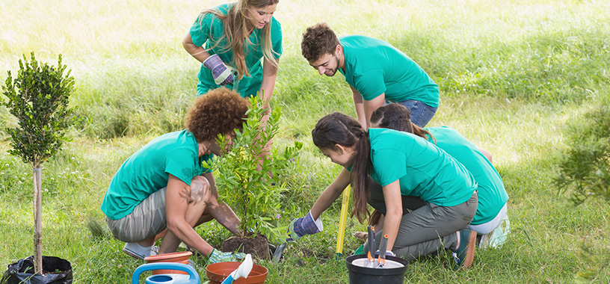
“look after the world; look after one another; take care of the fish and the birds, the animals and the reptiles, the trees and the flowers and the plants.”

Slide 54
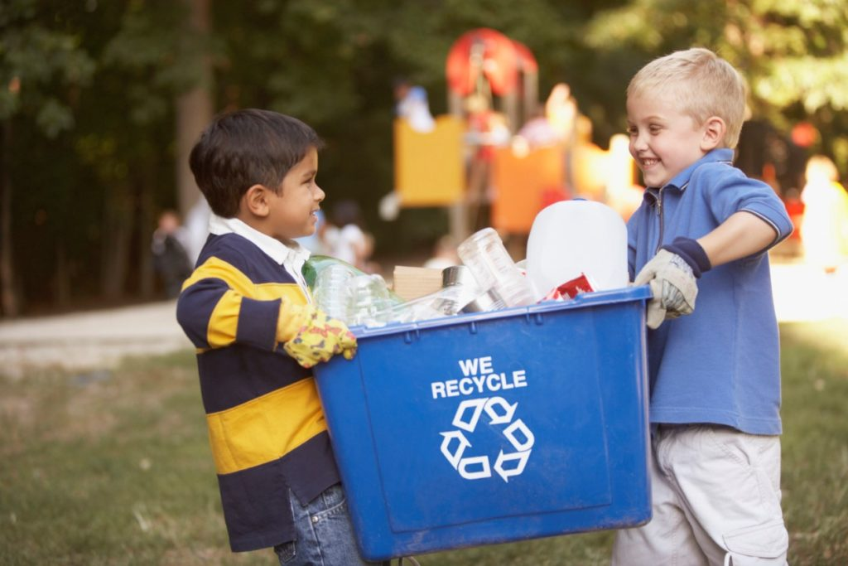
“look after the world; look after one another; take care of the fish and the birds, the animals and the reptiles, the trees and the flowers and the plants.”

Slide 55
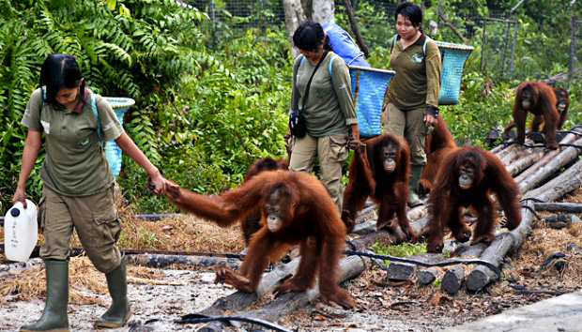
“look after the world; look after one another; take care of the fish and the birds, the animals and the reptiles, the trees and the flowers and the plants.”

Slide 56
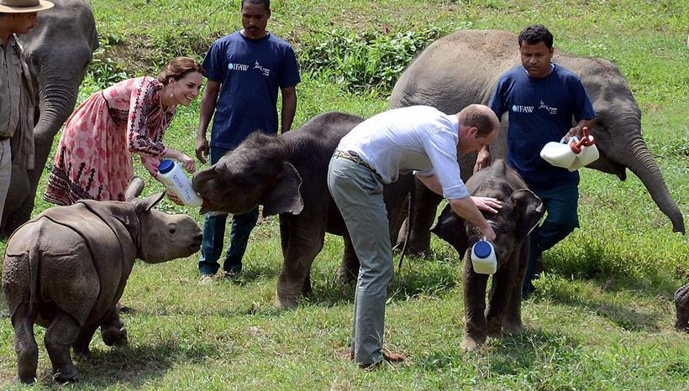
“look after the world; look after one another; take care of the fish and the birds, the animals and the reptiles, the trees and the flowers and the plants.”

Slide 57
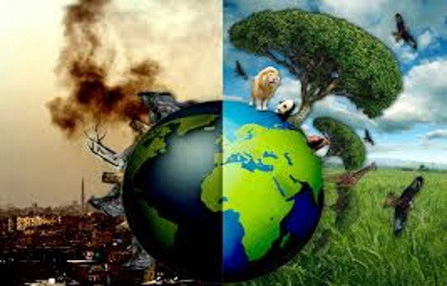
“look after the world; look after one another; take care of the fish and the birds, the animals and the reptiles, the trees and the flowers and the plants.”

Slide 58
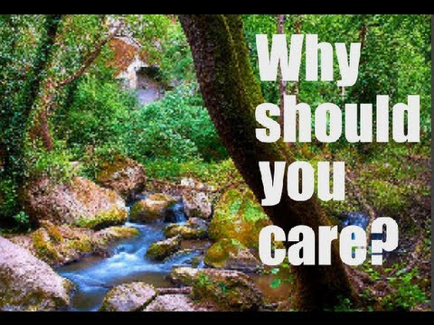
“look after the world; look after one another; take care of the fish and the birds, the animals and the reptiles, the trees and the flowers and the plants.”

Slide 59
Let us take a moment to reflect on what we have seen….
Was there a part that really stood out for you?
Would anyone like to share how that made them feel?

Slide 60
We will now pass the globes along the rows, please take a moment to say your own silent prayer for our Earth.

Slide 61

As Eco Warriors, we have made a plan with lots of ideas for helping our planet, such as:
To hold a Just One Tree Day to raise money for a deforested area.
To plant trees in the school grounds.
To litter pick around school grounds
To celebrate Earth Day in April.
To put posters throughout school to raise awareness and show how we can take easy steps to take care of the planet.

Slide 62
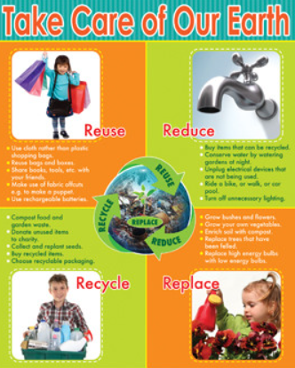

Poster awareness campaign
We have made some posters about caring for the environment to display around school.

Slide 63
Just One Tree Day
On Friday the 17th of October, we encouraged everyone in the school to wear green for a £1 donation. This was to raise awareness of deforestation around the world and we also raised £103 to donate, which will go towards replanting a deforested area in another country.

Slide 64
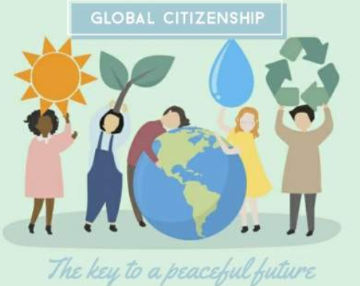


Our Mission
The Class 4 Eco warriors are going to unite St Charles for a greener future. We are going to continue to raise awareness and help everyone be greener citizens.

Slide 65
YOUR MISSION:
Your challenge is to think how you will be a greener citizen. Pick one thing you could do to help:
turn the lights off when you leave a room.
turn the tap off while you are brushing your teeth.
Walk or cycle to school.
Make sure your household recycles properly.

Slide 66
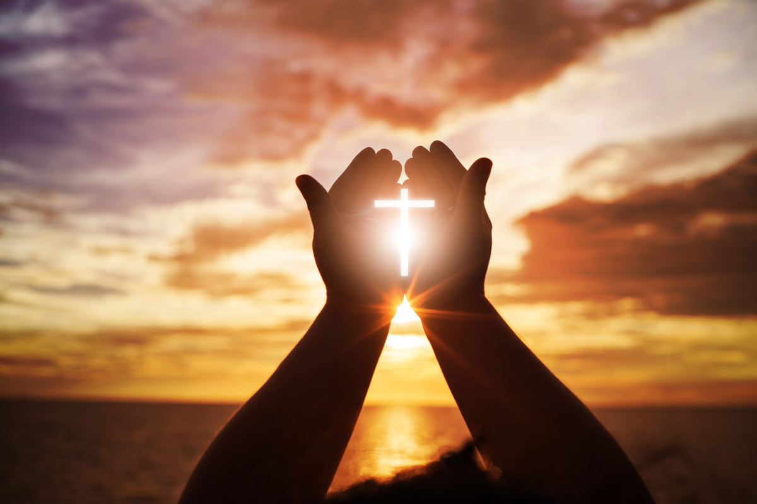
We will now say the Our Father together

Slide 67
Thank you for coming to our Class Assembly
We will end in the Sign of the Cross

