Slide 1




Eco team
Celebration of the word

Slide 2


Slide 3
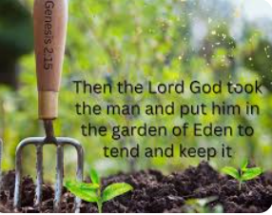
The word
Genesis 2: 15

Slide 4
Our why:
Genesis 2:15 “Then the lord God placed the man in the garden of Eden to cultivate it and guard it”
Our missions:
Waste – Food waste competition
Waste – Food drive + clothes jumble
Nature – Planting flowers to sell for charity

Slide 5


Slide 6
Your missions for this weekend:
Think of something you can do this weekend at home to support our missions. It could be thinking about leftover food and how not to waste it, it could be using less electricity or clearing out old clothes to give to a charity shop.
Do you have any Christmas jumpers at home that no longer fit you? Can bring them into school next week?
We will be selling these jumpers for £1.

